Slide 1


titulo
Hugo Veríssimo 124348
João Cardoso ??????
Foundations of Machine Learning 24/25

Slide 2
cONTENTS
Project Overview
Data Analysis
Machine Learning models
Results
Conclusions

Slide 3
Project Overview

Slide 4

The ProbleM
dsadsdasdas

Slide 5

State of the Art
dshuadhaish

Slide 6

Methodology
Raw Data
Data Assessment
Data Normalization
Train Multiple ML Models
Model Evaluation
Deploy Best Model
Logistic Regression
Support Vector Machine
Decision Tree
StandardScaler
Recall
F1-Score
Accuracy
Learning Curve
Confusion Matrix
Precision
train_test_split
RandomizedSearchCV

Slide 7
Data Analysis

Slide 8
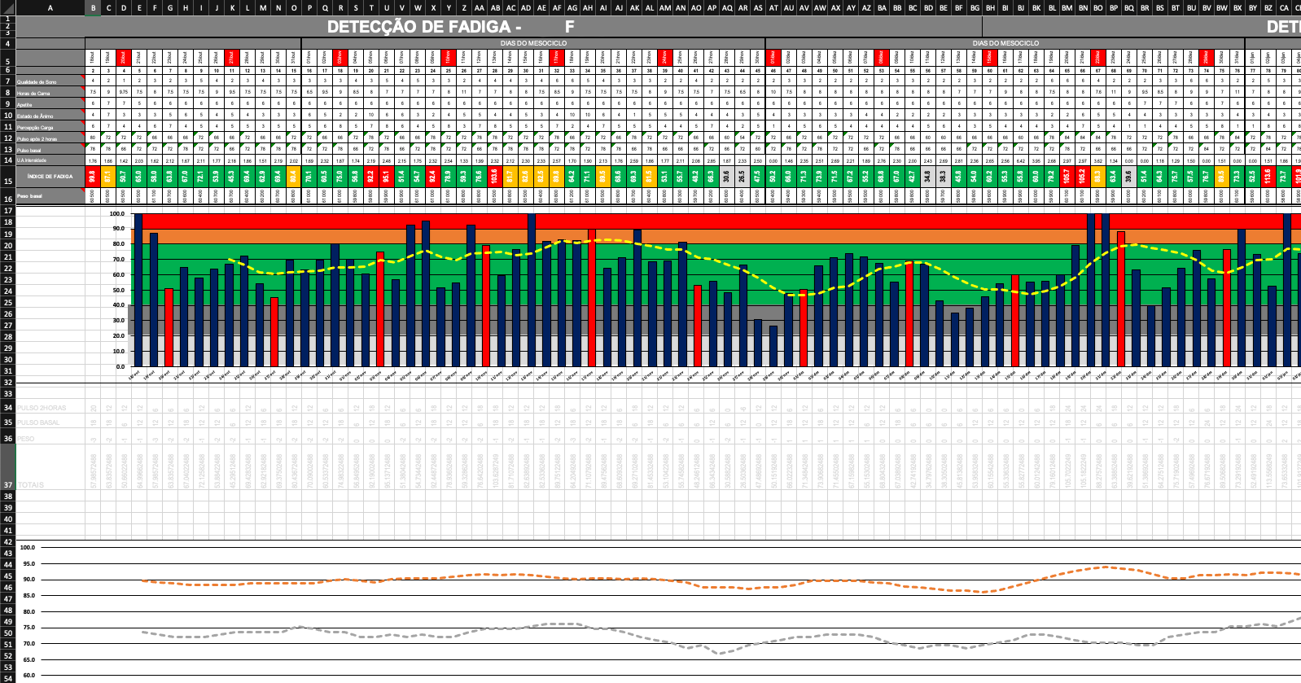
RAW DATA

Slide 9
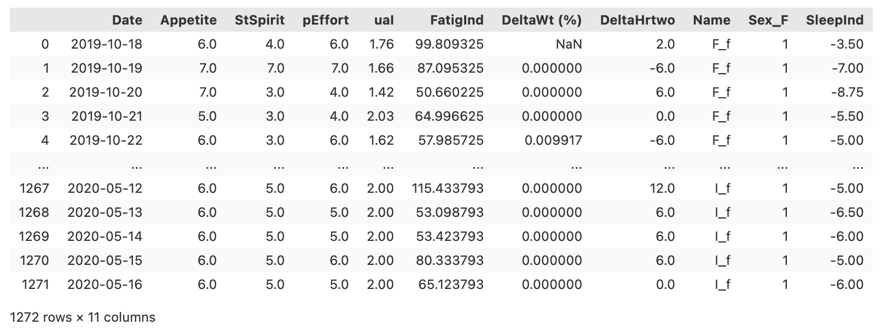
structured data

Slide 10
Overcoming Data Challenges

Slide 12
Feature Selection

Slide 13
Machine learning models

Slide 14
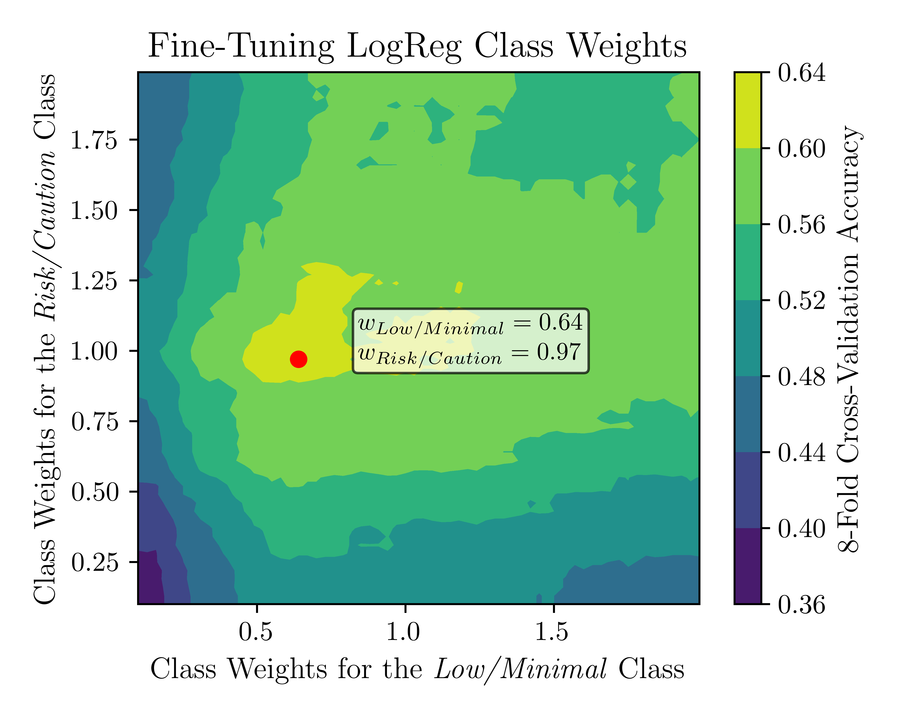
LOGISTIC REGRESSION

Slide 15
LOGREG: LEARNING CURVE

Slide 16
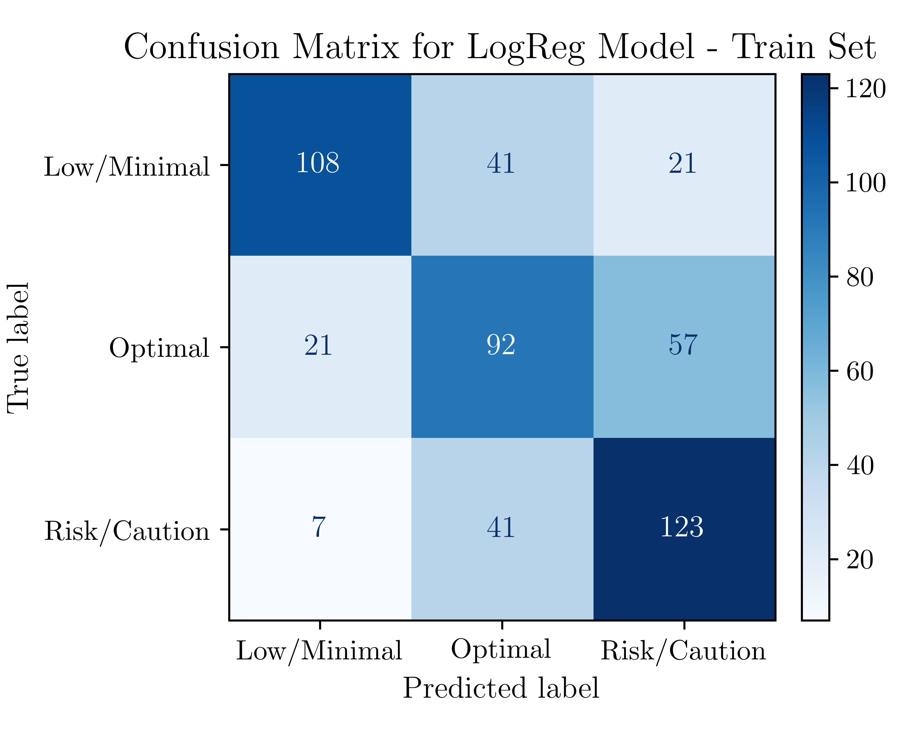
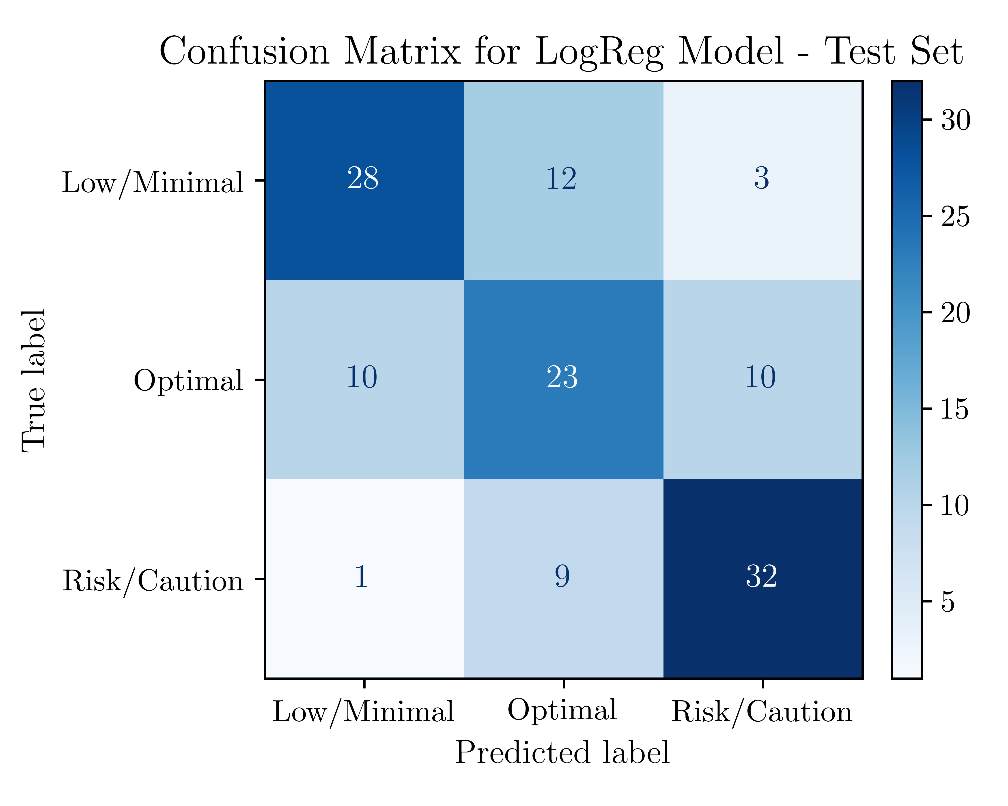
LOGREG: CONFUSION MATRIX

Slide 17
LOGREG: CLASSIFICATION REPORT

Slide 18
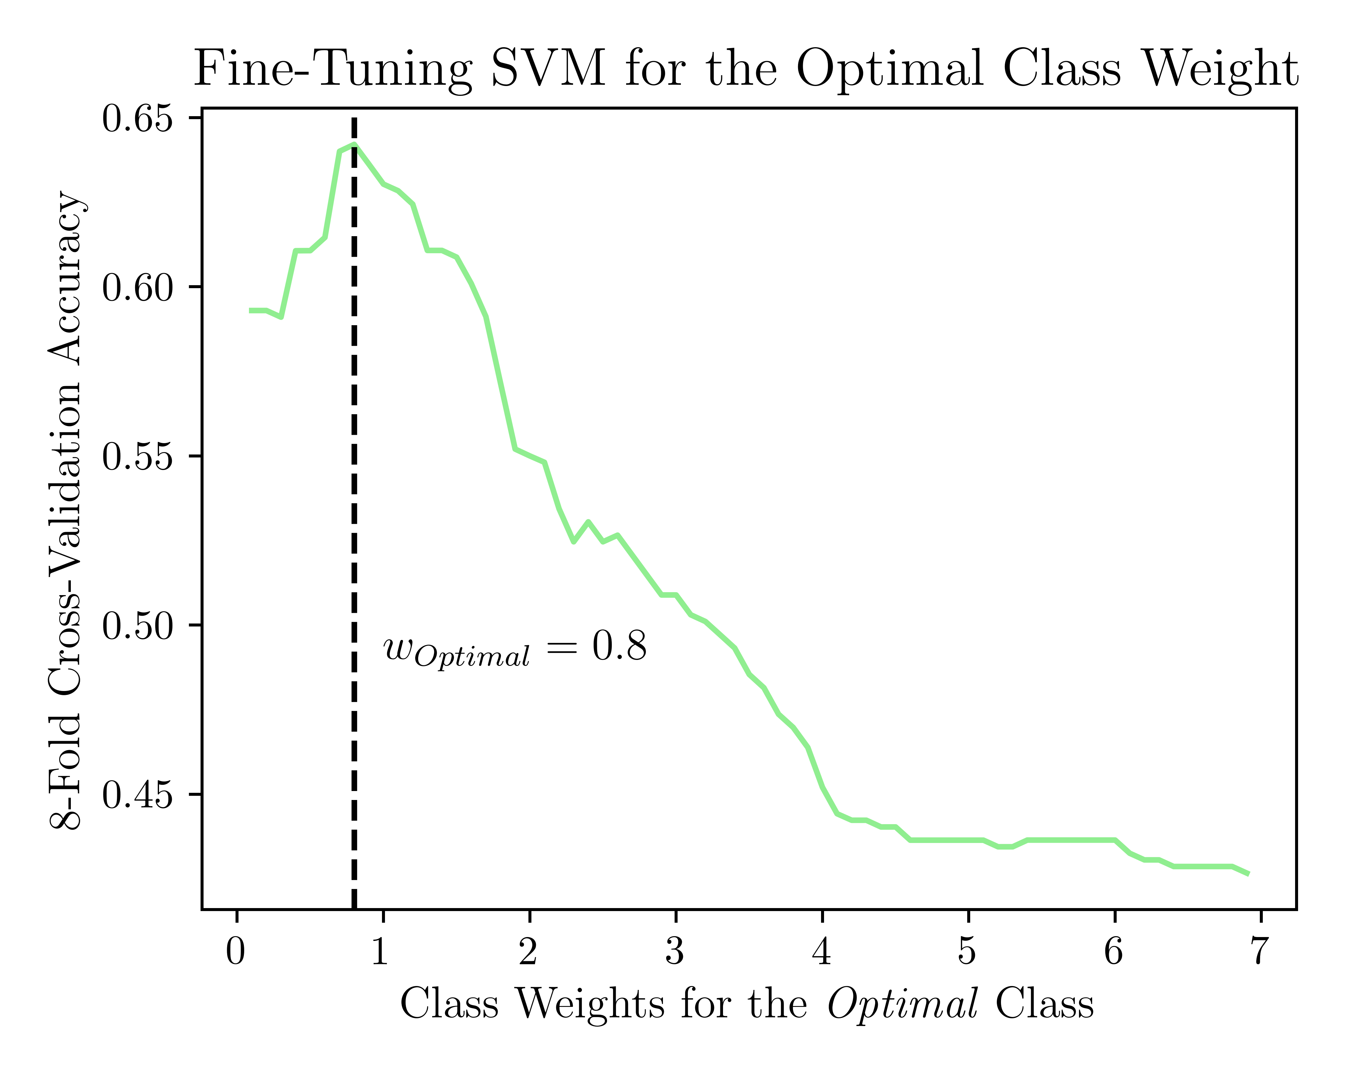
SUPPORT VECTOR MACHINE

Slide 19
SVM: LEARNING CURVE

Slide 20
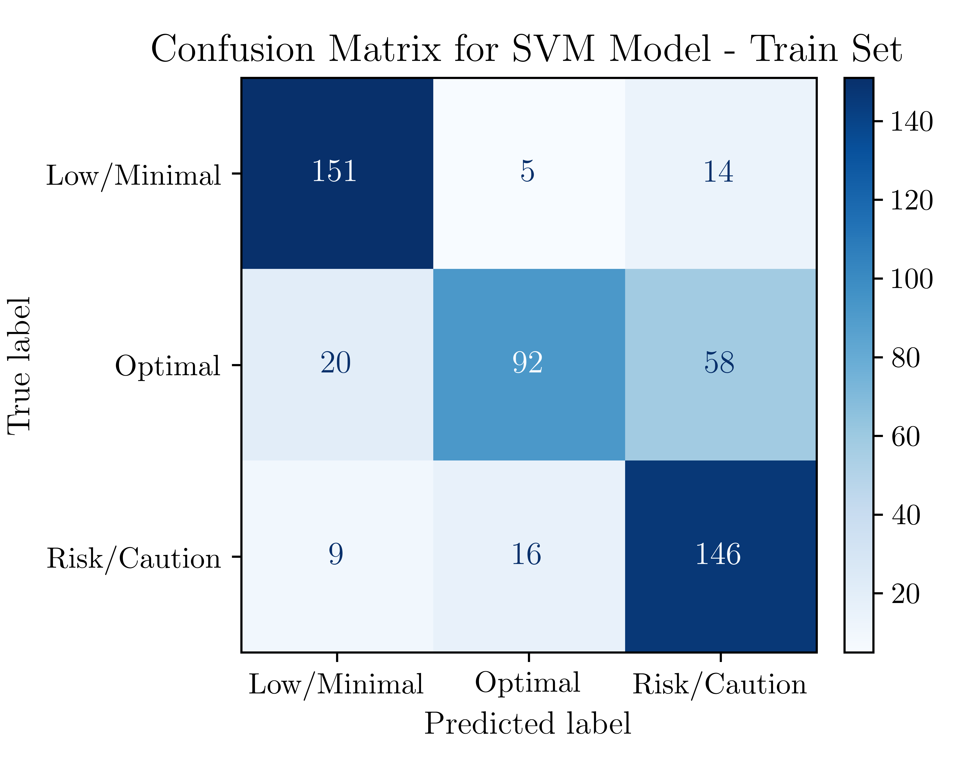
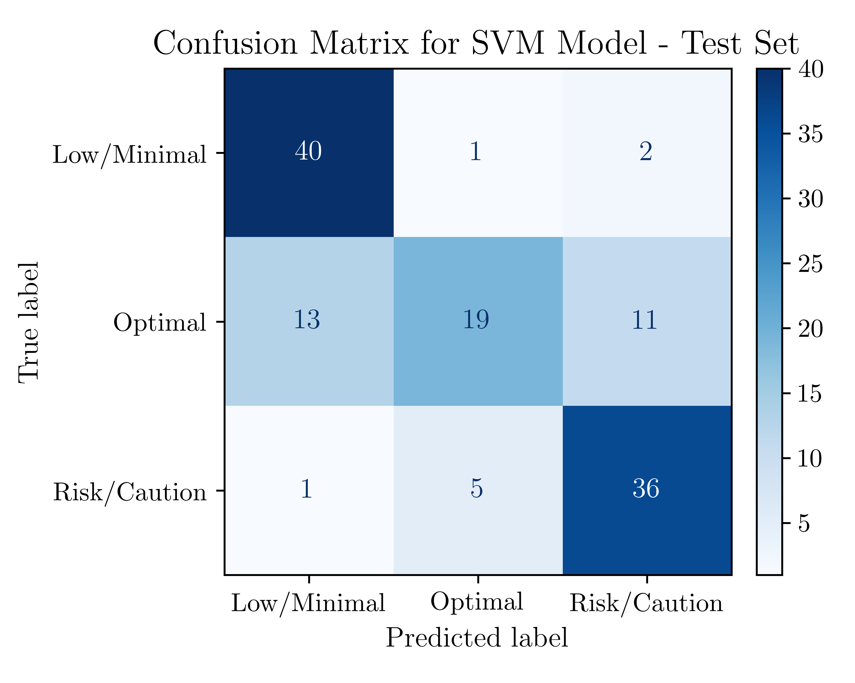
SVM: CONFUSION MATRIX

Slide 21
SVM: CLASSIFICATION REPORT

Slide 22
DECISION TREe

Slide 23
Dtree: learning curve

Slide 24
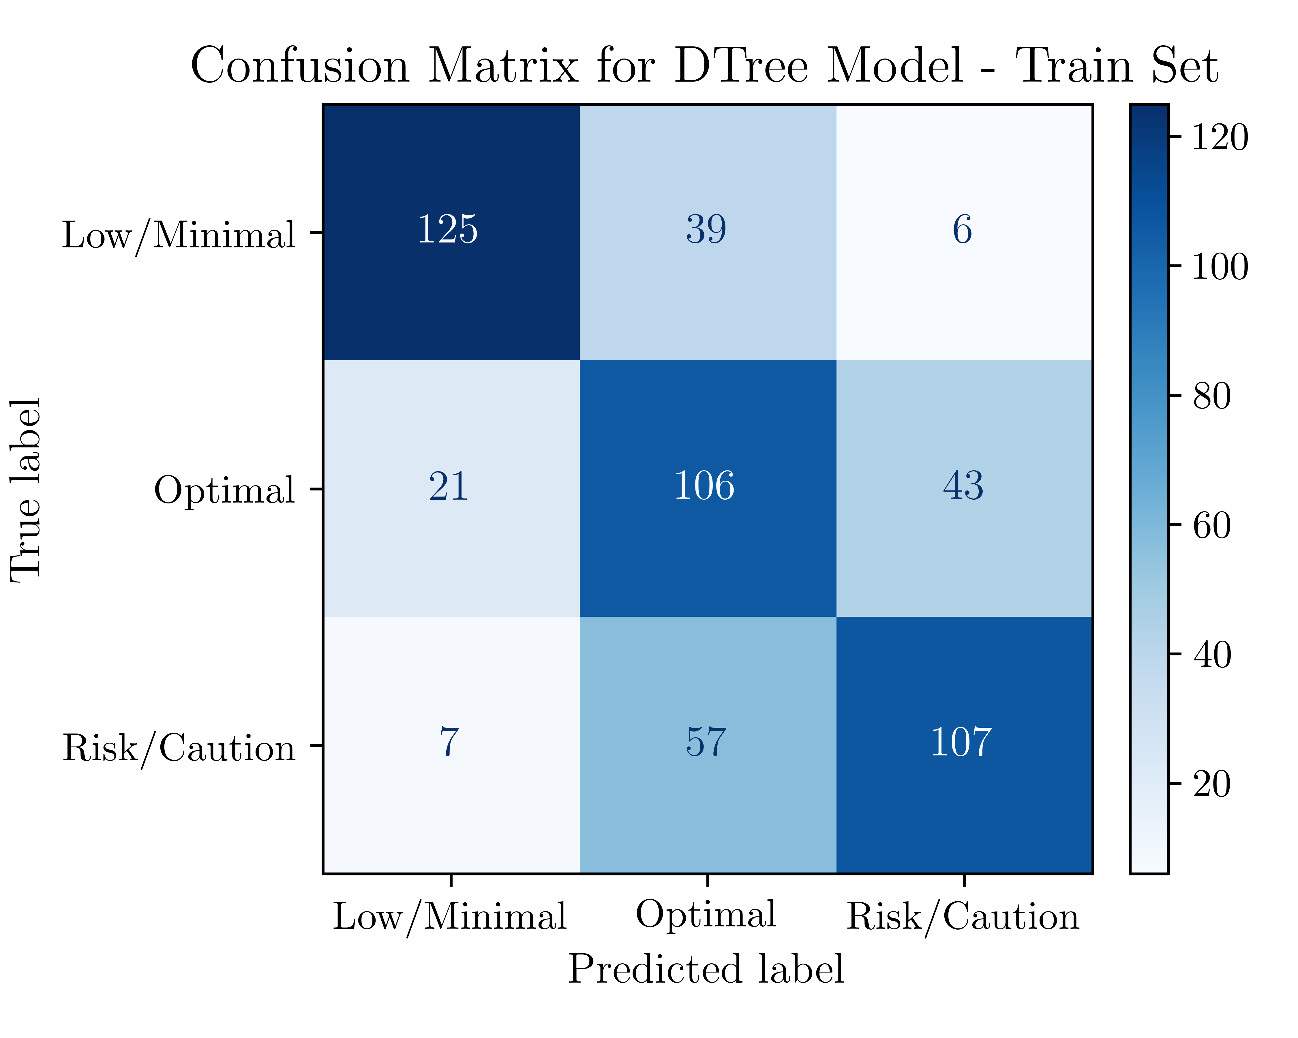
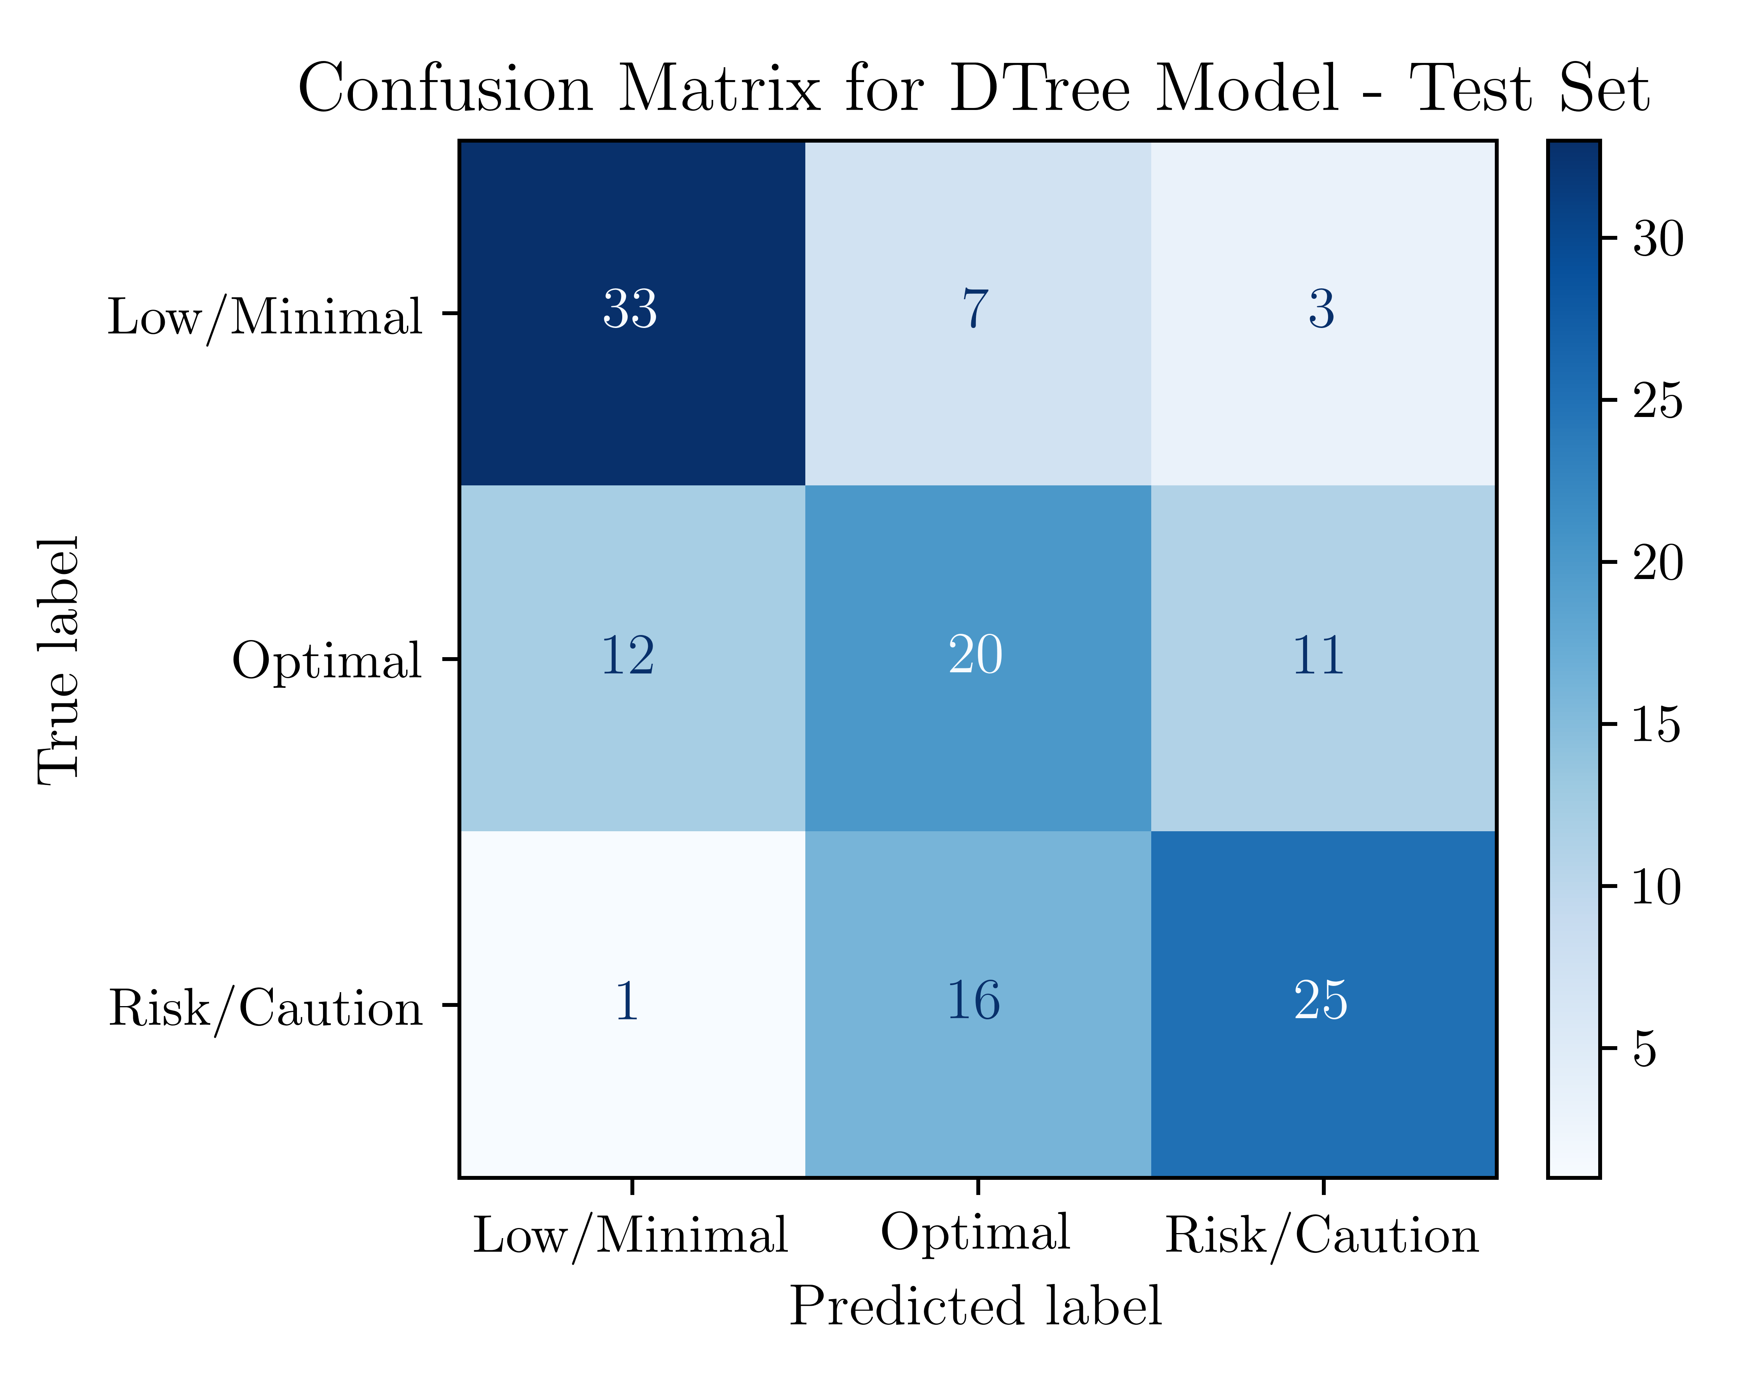
Dtree: confusion matrix

Slide 25
DTREE: Classification Report

Slide 26
Results

Slide 27
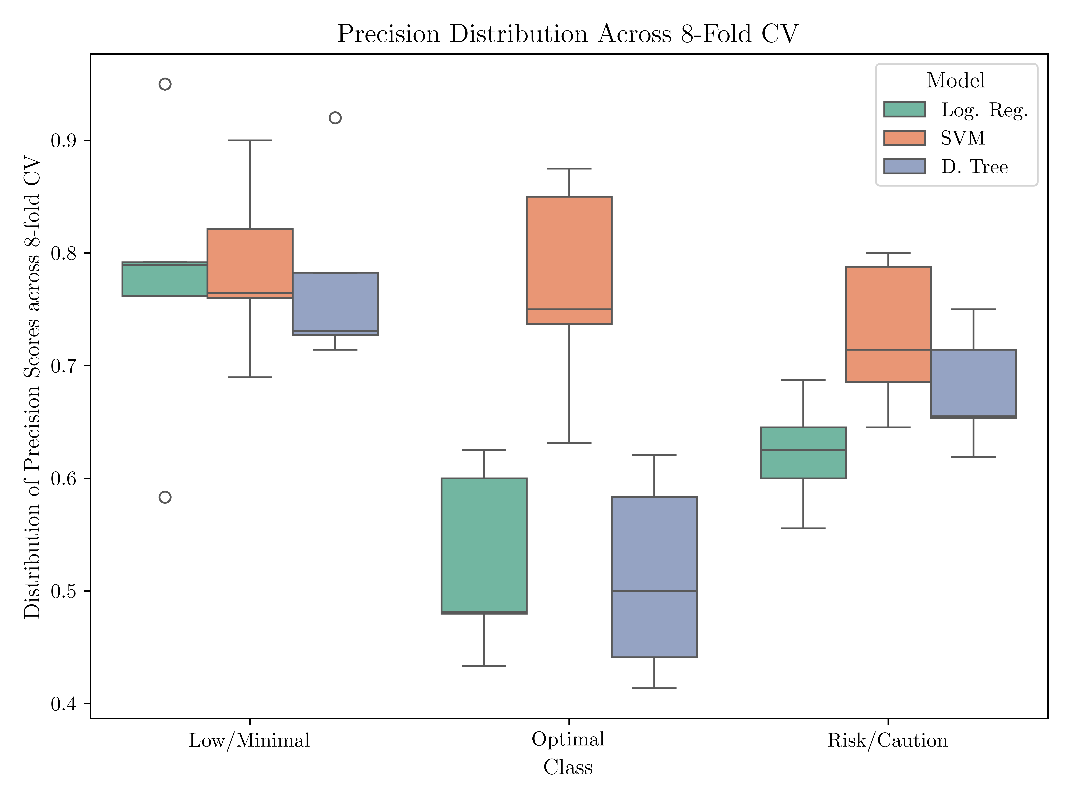
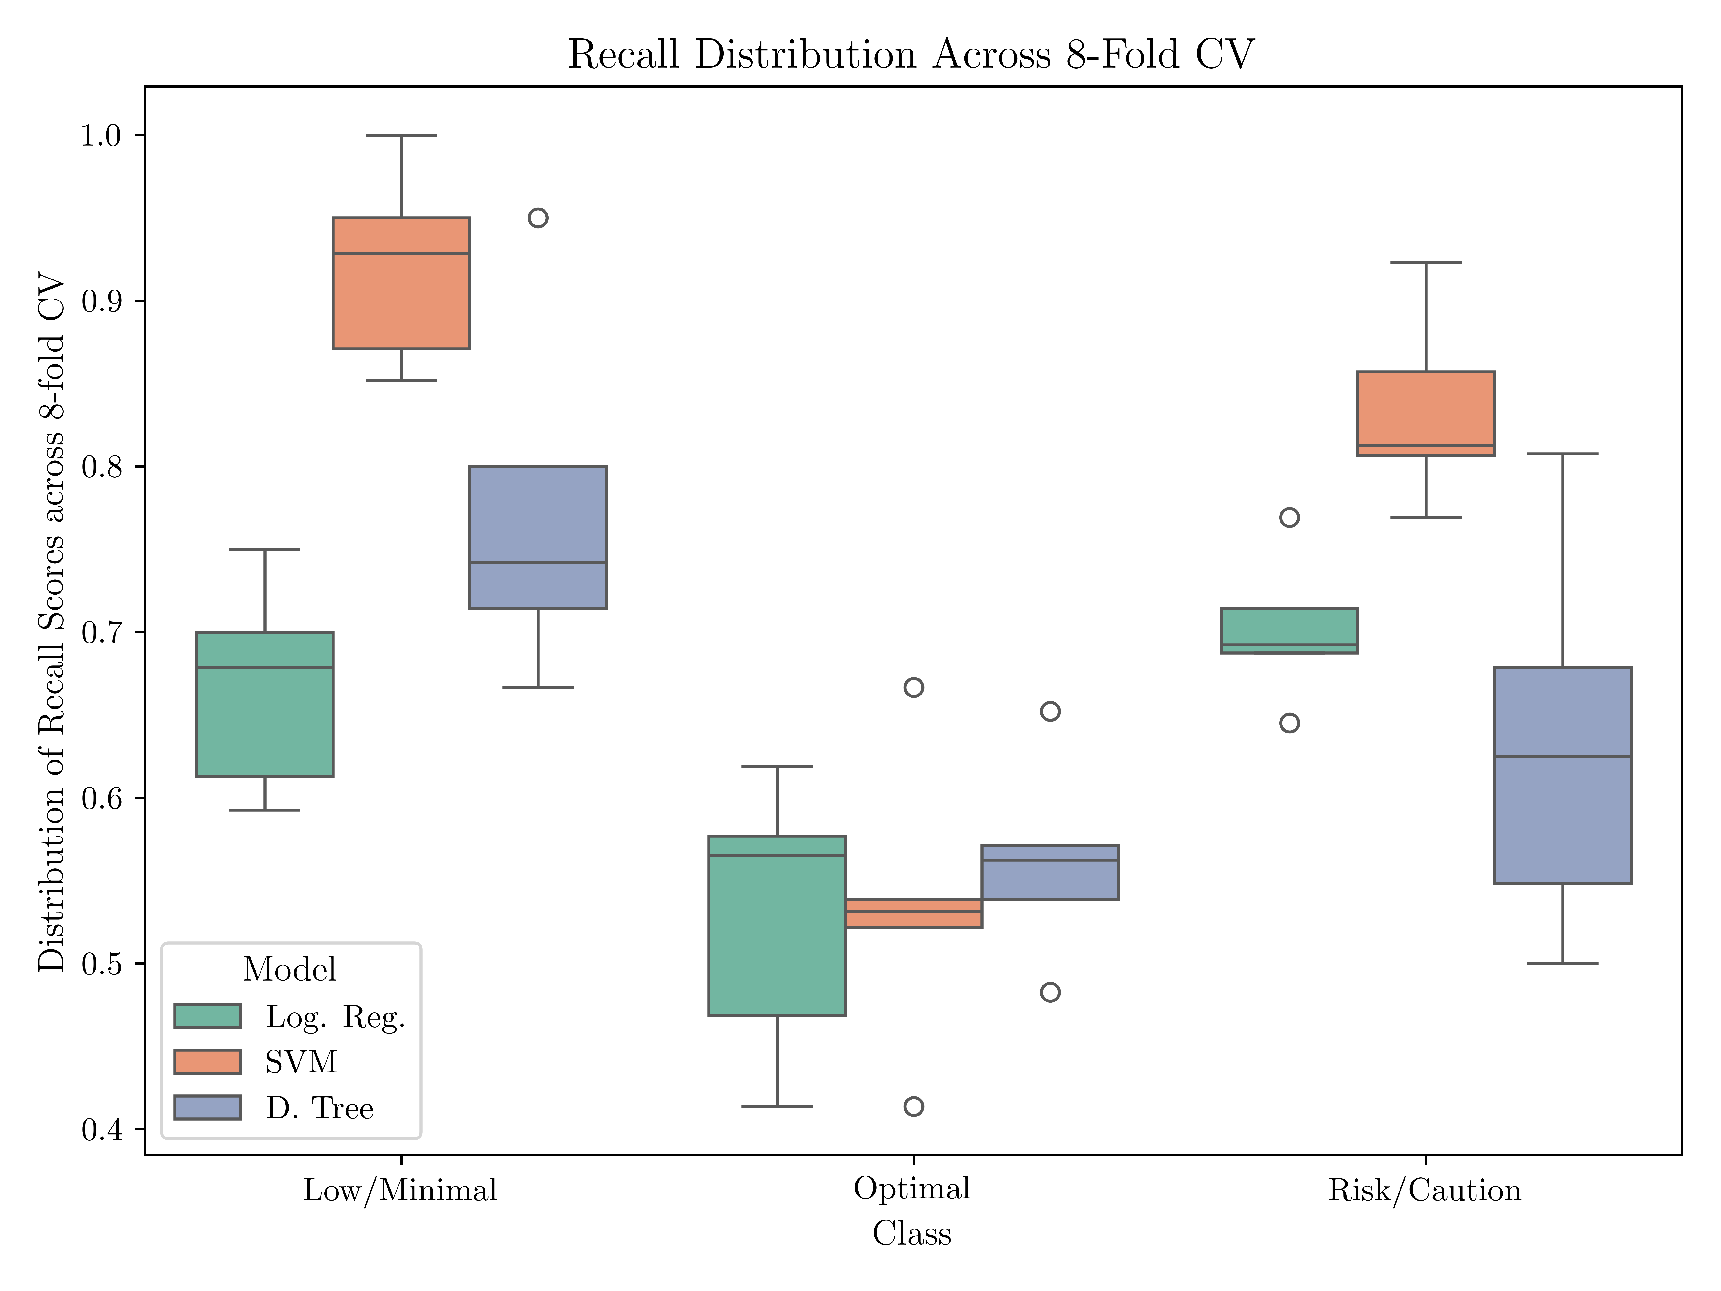
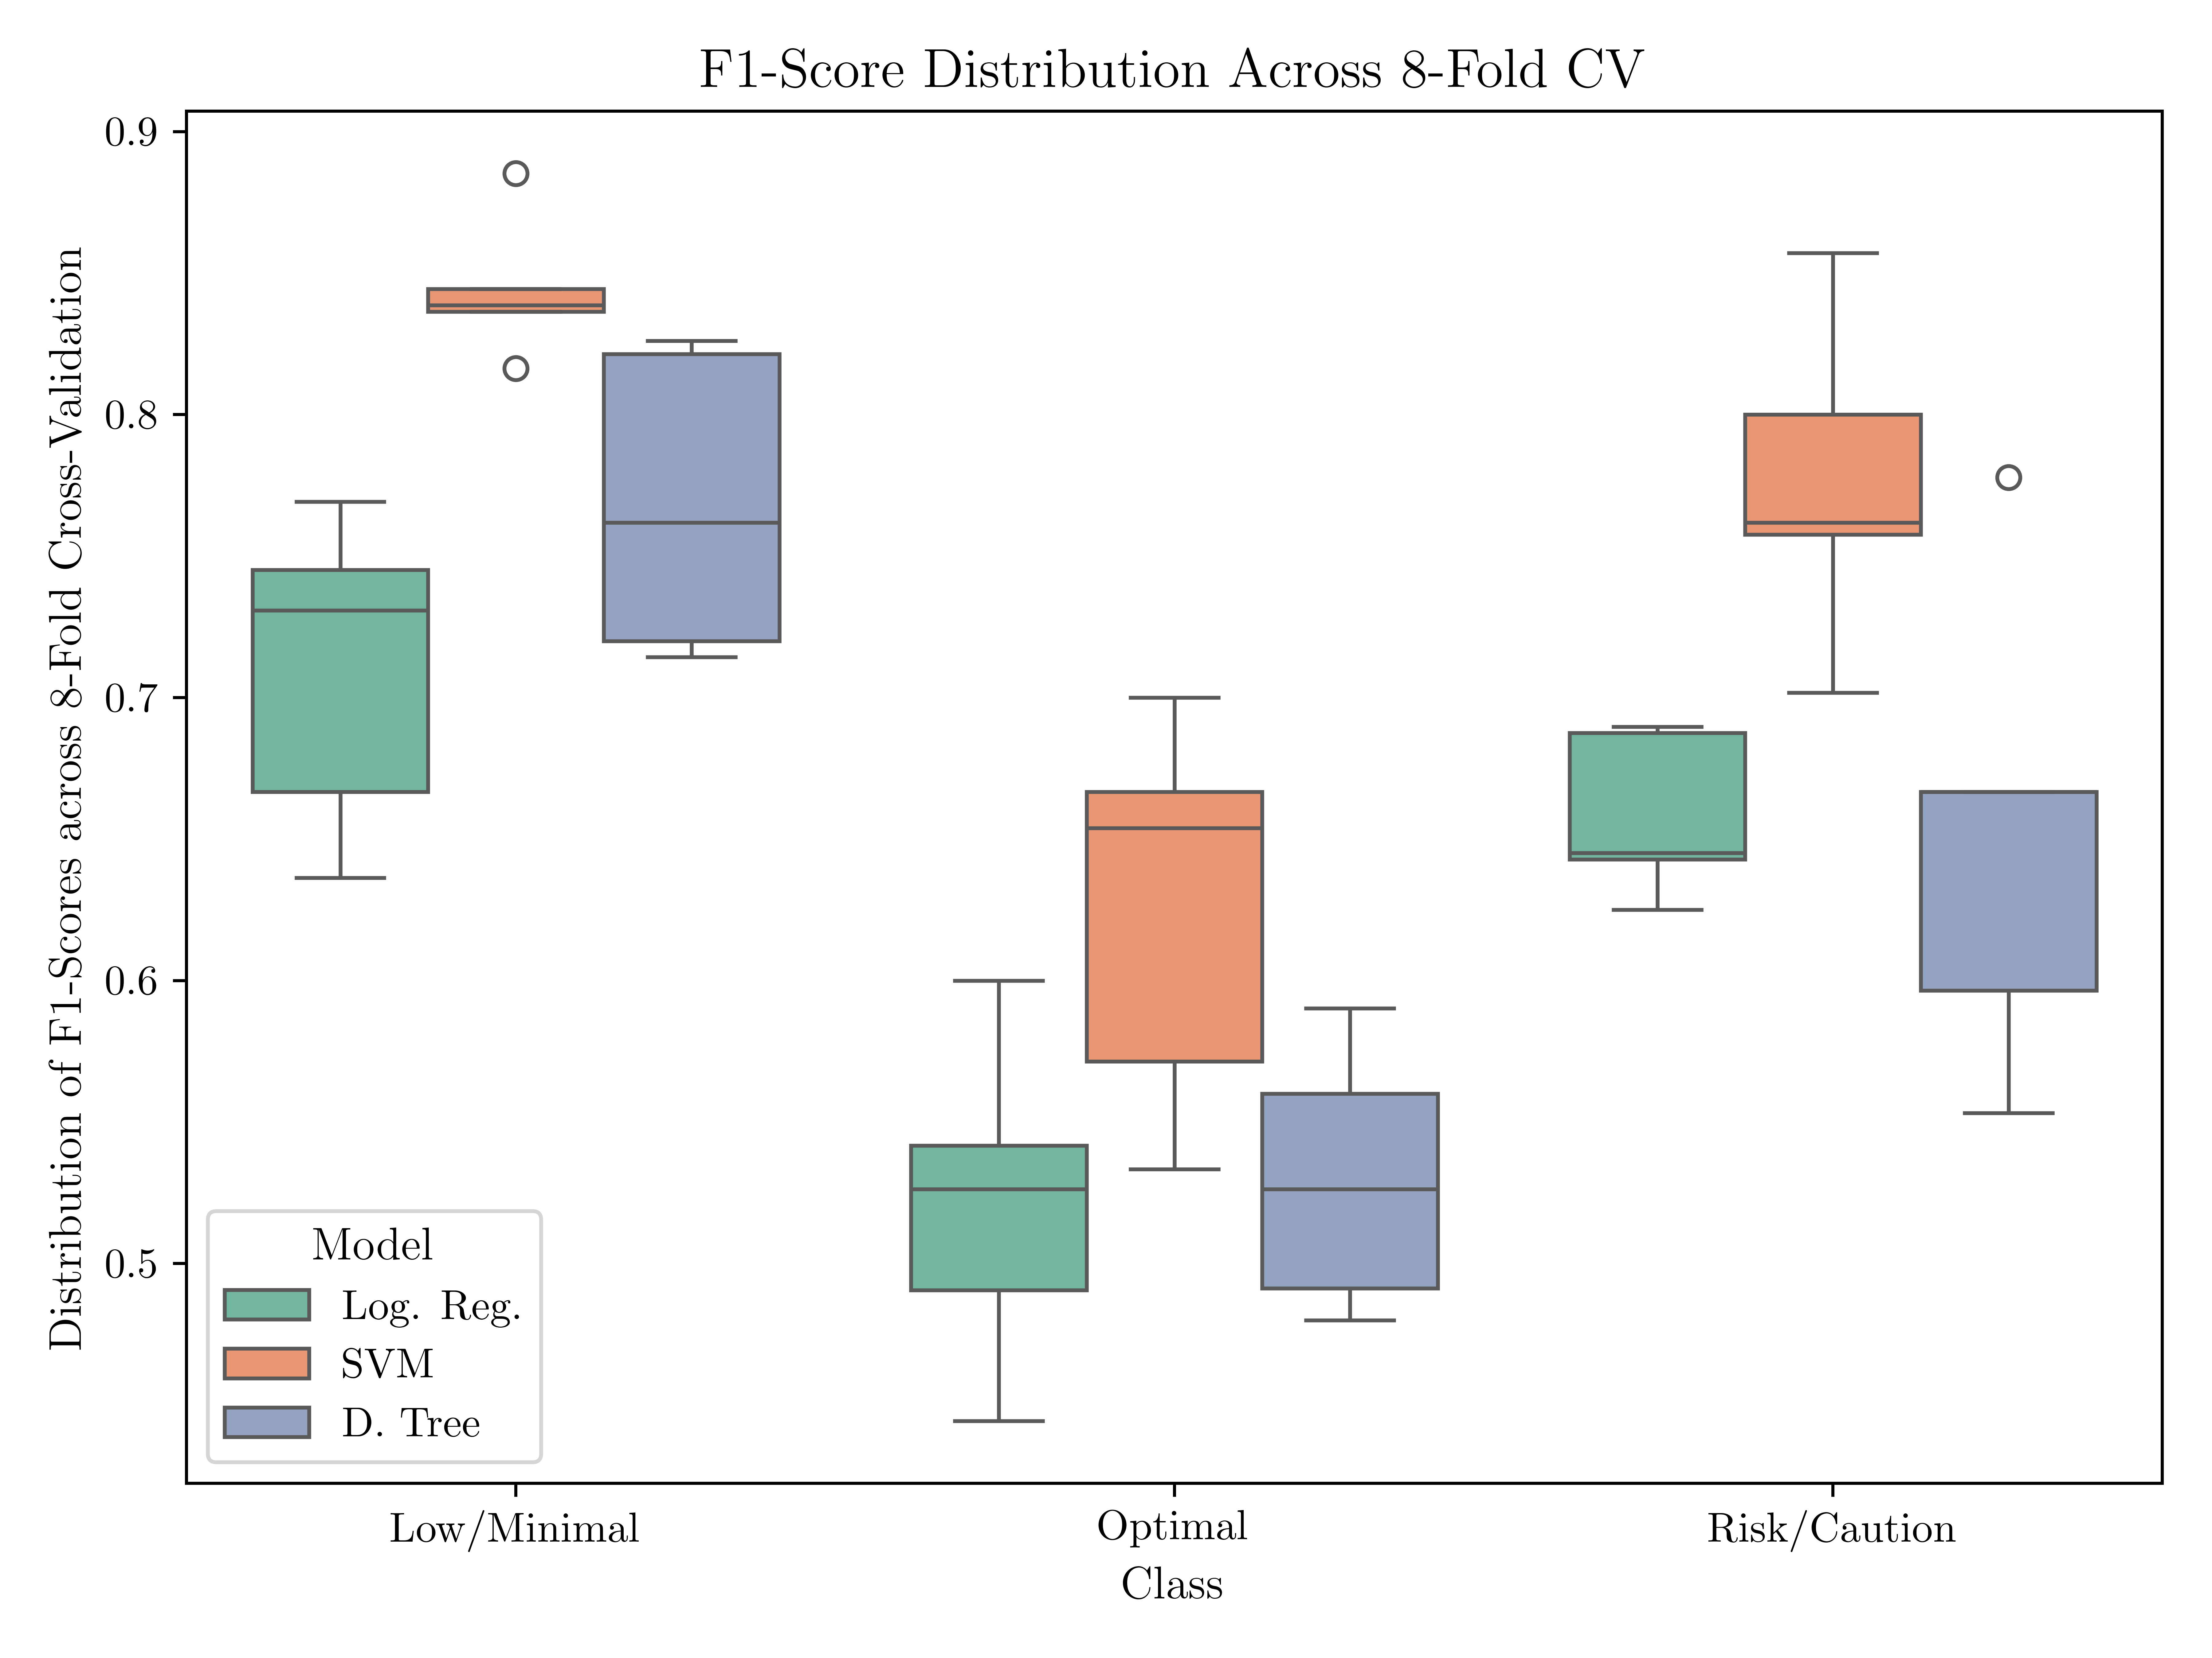
Performance Metrics

Slide 28
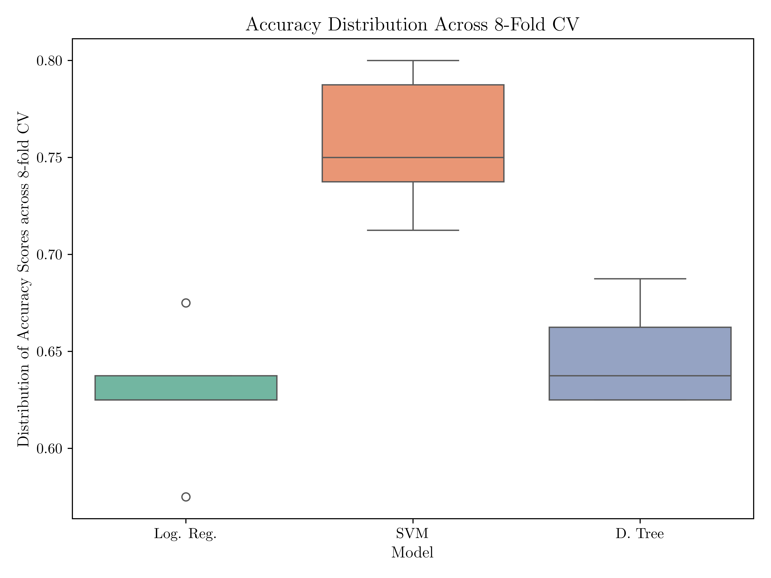
Performance Metrics

Slide 29
Decision Boundaries

Slide 30
Literature Benchmark
Comparacao a literatura

Slide 31
Conclusions

